Slide 1
Fundamental Technologies Used in PyPy JIT Compiler
PyConJP 2012
Ryotaro Ikeda, 2012/09/06

Slide 2


whoami
Studied about JIT compiler
But, I am now one of working adults (since this April)
And, I was a salesperson (telephone caller) during new graduate’s training
I almost forgot about PyPy! ;-(

Slide 3
Disclaimer
My English is extremely poor
My presentation skill is extremely low
Please feel free to
Ask any question anytime
Leave/Reenter
Of course I can explain in Japanese and English

Slide 4
Today’s topics
What is PyPy?
What is JIT compiler?
What is unique features of PyPy JIT compiler?

Slide 5
What is PyPy?

Slide 6

Please raise your hand if you know briefly what PyPy is?

Slide 7
PyPy is regarded as …
Faster python implementation
Framework used to develop language implementation
Both are definitely correct!

Slide 8
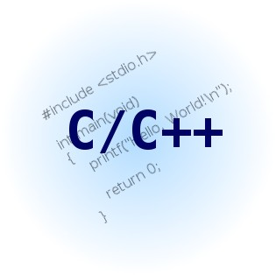
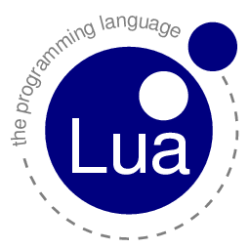


Current woes and PyPy’s goal
Problem
Creating interpreter requires a lot of work
For performance!
Language-based programming
PyPy’s goal
To be able to create interpreter easily
With high-level language like Python
Without giving up performance

Slide 9

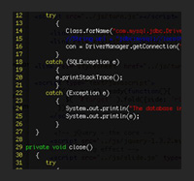
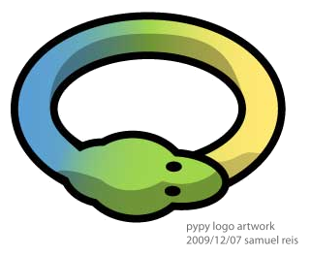
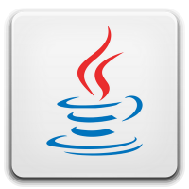

Principle what PyPy do
Toolkit to translate interpreter written in RPython to other backends(C/CLI/Java..)
C (native)
Java
Implementer
Interpreter code
Written in RPython
PyPy
CLI

Slide 10
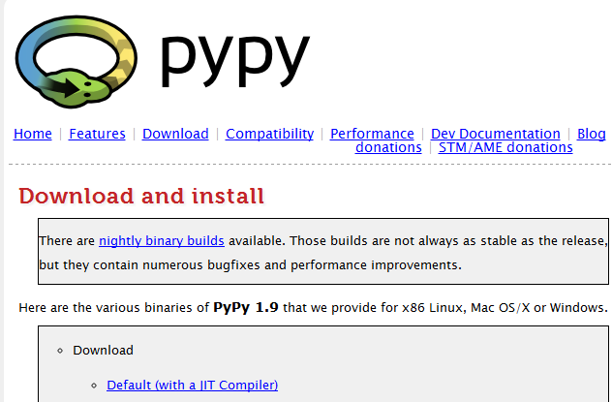
Python implemented by RPython
Python
Implementer
C (native)
Python code
Written in RPython
PyPy
This is what they know!

Slide 11
What is RPython?
It is abbreviated for Restricted subset of Python
Only single inheritance is allowed
“For loop” only supports built-in type
Generator is supported, but exact scope is very limited
Dynamic dispatch to class is not supported
These are required to static analysis
(it is for translating other back-ends)
* RPython can be executed by CPython!

Slide 12
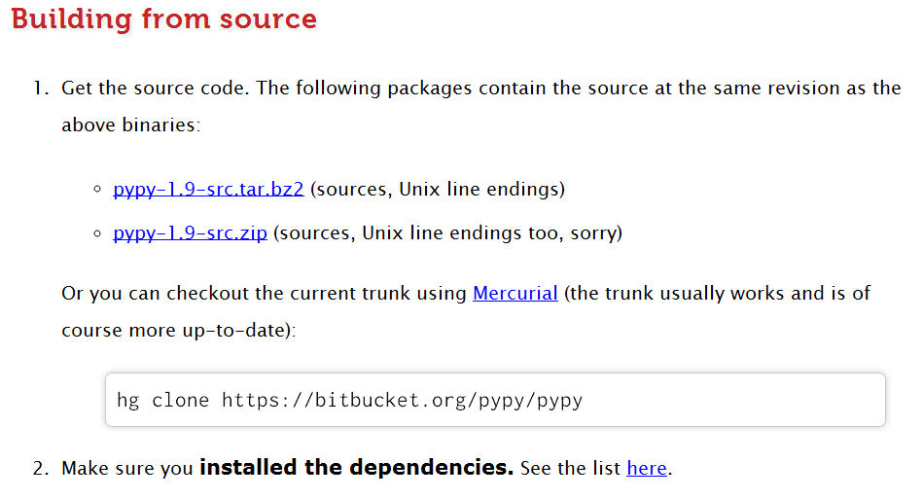
How to use PyPy (as framework)?
1. Download source code edition of PyPy
* Toolchain is not contained in binary distribution

Slide 13
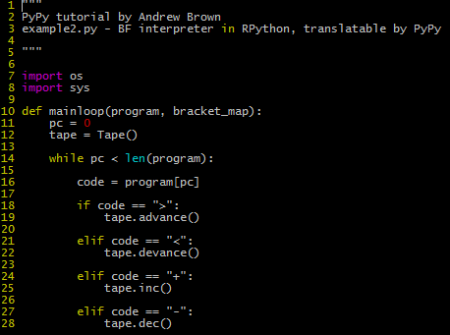
How to use PyPy (as framework)?
2. Write interpreter code in RPython
* Note that it can also be executed by CPython

Slide 14
How to use PyPy (as framework)?
3. Use translater

Slide 15
How to use PyPy (as framework)?
4. Translating…

Slide 16
How to use PyPy (as framework)?
5. Faster version of your implementation is made!

Slide 18
How to use PyPy (as framework)?

Slide 20
Templates
Problem
Problem

